Slide 1

Predicting Heart Failure Survival

Slide 2
CONTENTS:
Abstract
Dataset
Approach
Model Evaluation

Slide 3
Abstract
In this project, we try to predict if a patient with a history of heart failure is going to survive or not based on several features like age, serum creatinine, blood pressure, etc.
We start with data exploration by creating boxplots, checking correlation plots and scatter plots to get an idea about the distribution of data
We then create a base logistic regression model and then use different model selection processes to get the best model
We finally conclude our analysis on the data based on the different plots and models.

Slide 4

Data Exploration
The dataset contains 1 target variable and 12 independent features.
The target variable is ”Death_event” which is a binary variable which tells us whether the patient survived or not.
The other features which will help our model predict this are: Age, Anaemia, High blood pressure, Creatinine phosphokinase, Diabetes, Ejection Fraction, Sex, Platelets, Serum Creatinine, Serum Sodium, Smoking and Time.
One can refer the data source to get more information about individual features.
The dataset only contains numerical data. Some features are continuous, and some are Boolean.
The dataset has 299 observations. We check if there are any missing values in any of them. From the analysis we find that there no null values present in the dataset.

Slide 5
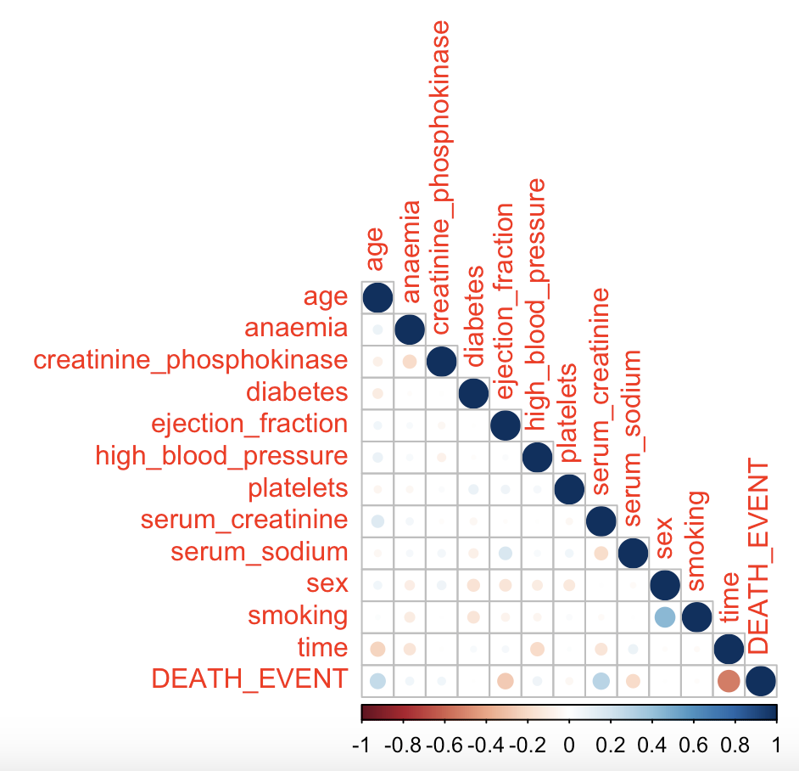
Data Exploration
We start by checking the correlation matrix to see if there are any notable features that should be included in the model
Features like age and serum creatinine have a positive correlation with target variable
Ejection fraction and serum sodium have a negative correlation with target variable
Maybe some these variables will prove to be important in the final model we build

Slide 6
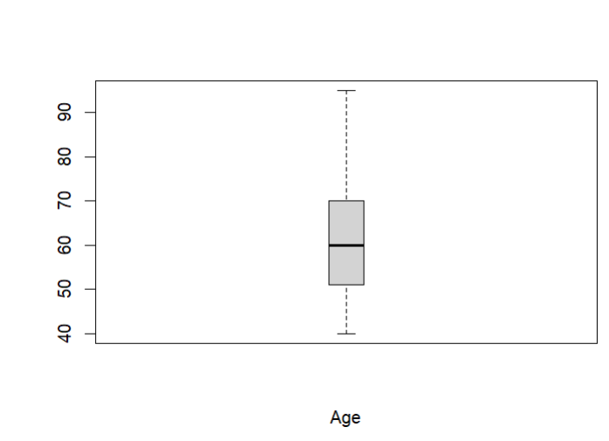
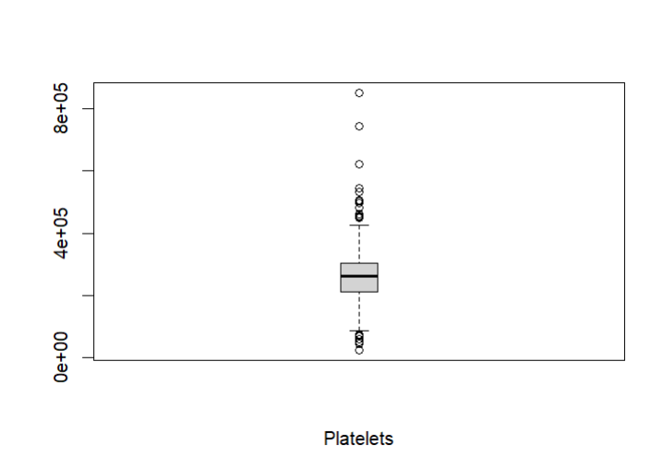
Data Exploration
Age and Platelets have average total mean.
Diabetes and Sex have totally opposite totally means.
It has been noticed that they have moderate variability from the median.
However, Platelets has the most outliers.

Slide 7

Model Building And Evaluation
In this section we talk about the model building and selection process.
We start by creating a full model where we include all the features present in the dataset.
This is a starting point in our model building process and this will later be used in processes like stepwise selection, forward selection and backward selection.
Using different model selection procedures we can get a good balance between model accuracy and complexity.
We check the deviance and Pearson goodness-of-fit statistics to compare the different models we build.

Slide 8
Model Building And Evaluation
The full model includes all the independent variables to predict the target variable.
It will have comparatively more complexity compared to other models and might cause problems like overfitting as well.
After running the code, we find the null deviance for our dataset is 375.35 with 298 degrees of freedom.
The residual deviance of the full model is 219.55 with 286 degrees of freedom with an AIC score of 245.55 .
The coefficient estimates and their respective standard deviations are present in the next slide

Slide 9
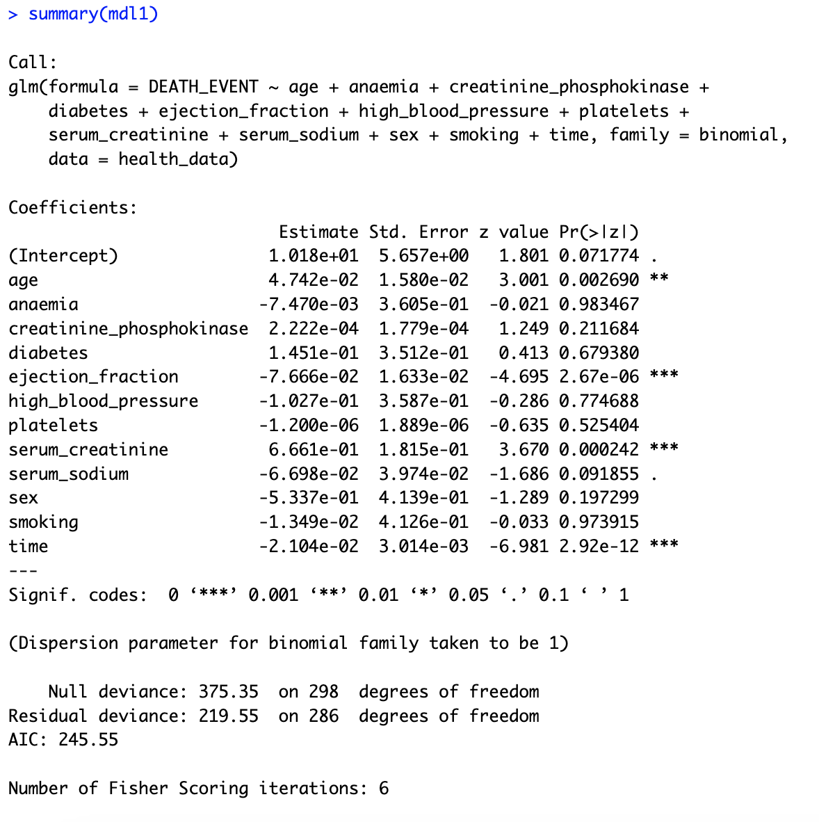
Model Building And Evaluation
From the summary, we can see that there are a few variables who have p-value < 0.05. Namely these features are Age, Ejection fraction, Serum Creatinine and time.
These features also had the most correlation with the target variable as previously seen in the correlation matrix.

Slide 10
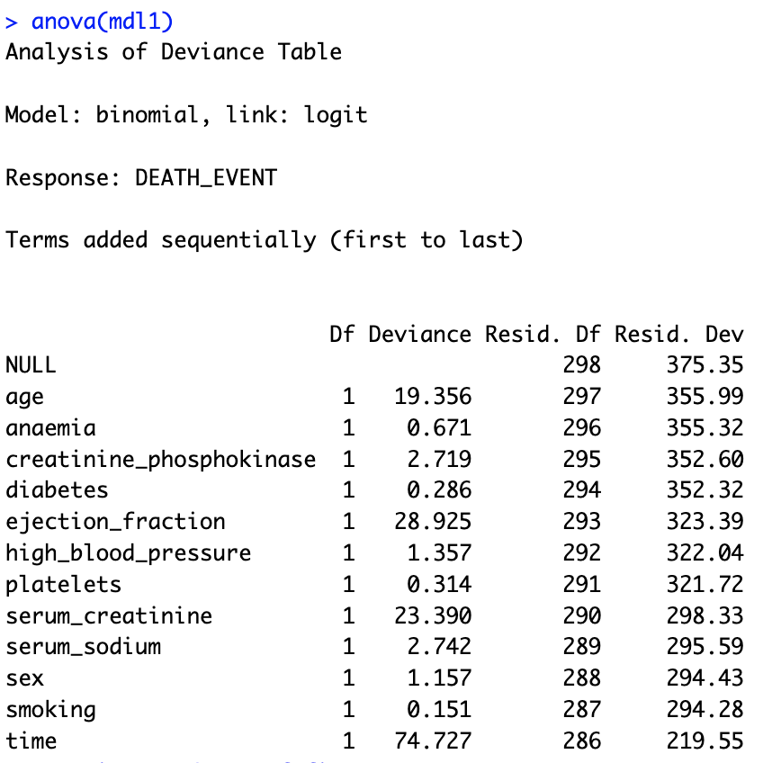
Model Building And Evaluation
Even though anova table in logistic regression does not directly assess the overall model fit like linear regression we can still use it to observe how each feature effected the model. Although, this must be compared with other feature selection techniques.
From this table, we can see how the residual deviance changed with the addition of each feature.
The most change in residual deviance was from the same features that had the smaller p-values.
The most change in residual deviance coming from “time” and then “ejection_fraction”, “serum_creatinine”,”age” respectively.

Slide 11
Model Building And Evaluation
To evaluate the goodness of fit of the model we look at the deviance and pearson residual statistics.
We can see these values when divided by the degrees of freedom are less than unity.
This suggests that the model provides as a satisfactory fit to the data.
The p-values for these metrics are also high which again suggests that the model is a satisfactory fit.
For testing the overall significance of the model using chi-square test, we get an extremely low p-value which suggests that this model is better than no model at all.
Criteria | Value | DF | Value/DF | p-value
Deviance | 219.55 | 286 | 0.76765734 | 0.9986493
Pearson | 258.7833 | 286 | 0.90483671 | 0.8745419

Slide 12
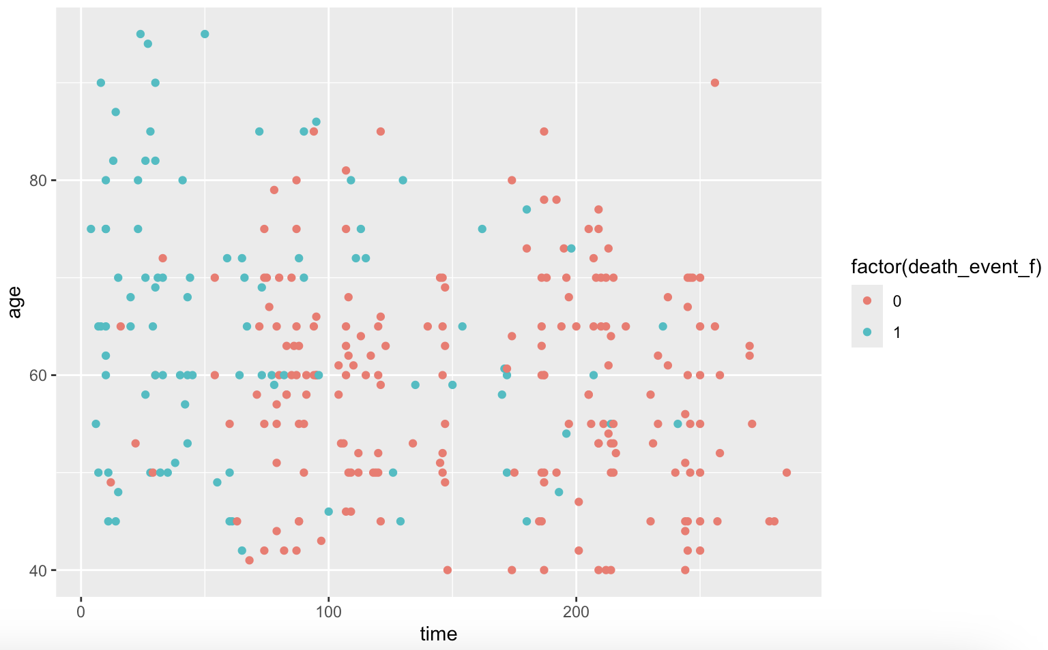
Model Building And Evaluation
As we can see from the previous analysis, there is one feature which is playing a major role in our model which is time
This feature describes the time after which the follow up was done. We can say that if the follow up time is more, it is more probable that the patient was alive.
Due to this reason, we cannot actually consider time as it is not describing the patient, but the follow ups done by the clinics.
Let's look at the scatterplot of data points with respect to time and age.
We can see in the scatterplot the density of green points is less towards right indicating that chances of survival is more when follow up time is more

Slide 13
Model Building And Evaluation
We now try to create models where we are not using time as an independent variable.
It will affect the performance of the model but will be a more accurate representation of predicting patient survival based on patient health
We again start of by creating the full model and then printing the summary and the anova table
The residual deviance this time is 294.48 for the full model with an AIC score of 318.28. As time was a major factor in predicting patient survival in the previous model, the deviance residual of the new model is comparatively low.
For testing the overall significance of the model using chi-square test, we get an extremely low p-value which suggests that this model is better than no model at all.

Slide 14
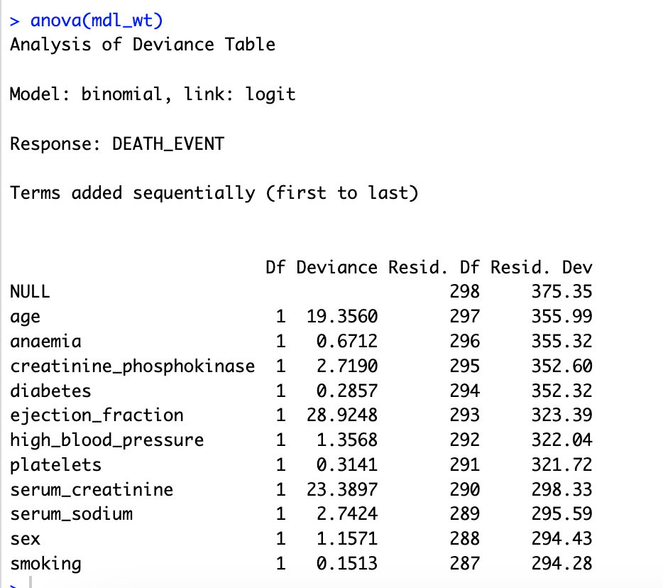
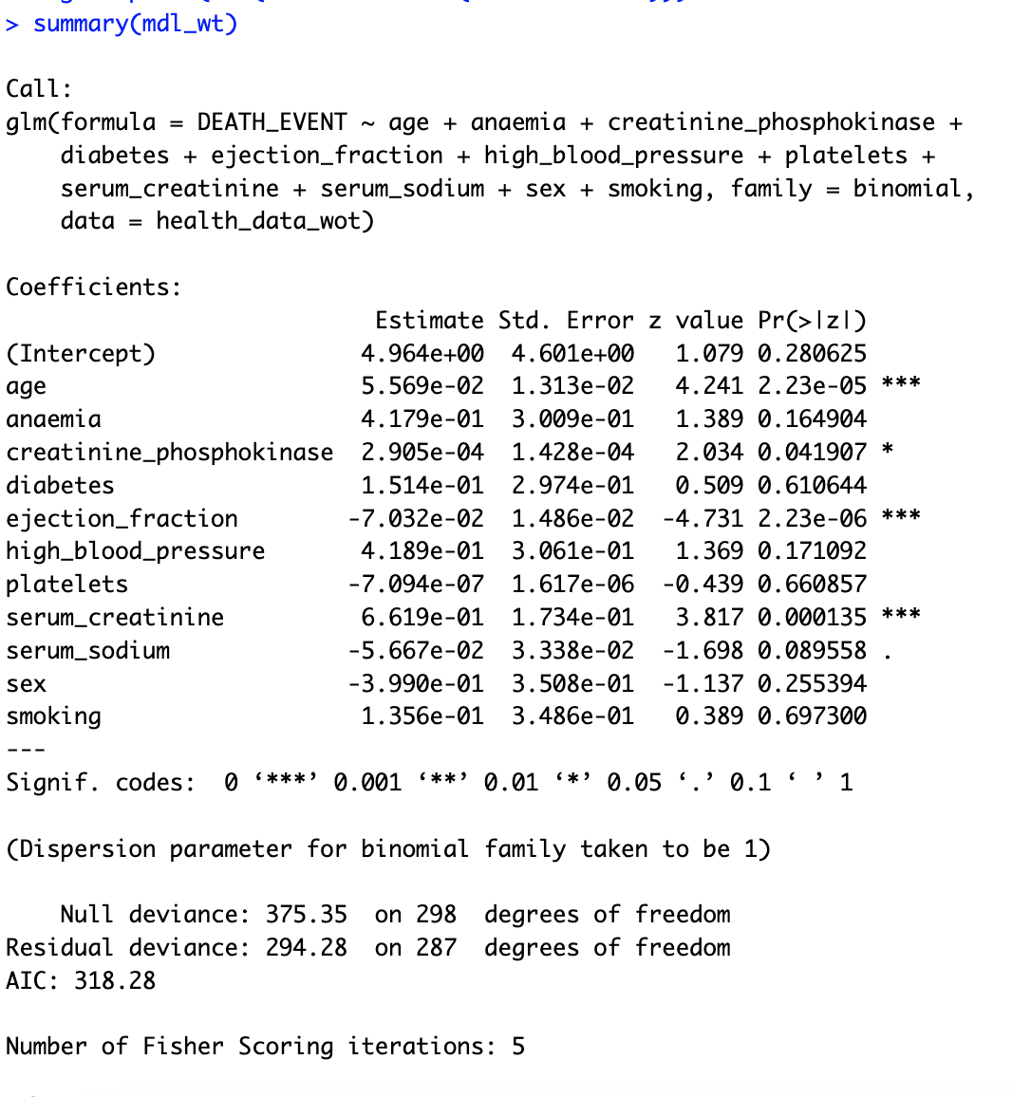
Model Building And Evaluation

Slide 15
Model Selection
In this process, we use forward, backward and stepwise selection to select the best model in terms of having a good performance while keeping minimal complexity.
We than proceed to do goodness of fit check using deviance and pearson residuals to compare with the full model.
We use the AIC metric while doing model selection as it will help us provide a measure of the relative quality of a model while penalizing for model complexity.

Slide 16
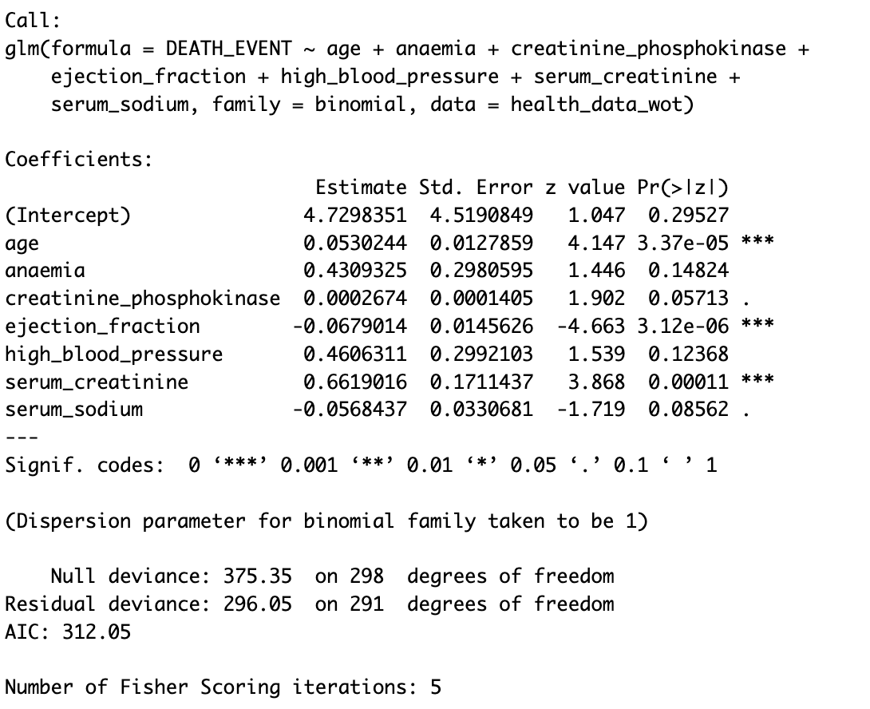
Model Selection
We first try to run stepwise selection using AIC metric.
The resulting model had the following features: Age, Anaemia, Creatinine, Ejection fraction, Serum creatinine, Blood pressure and Serum sodium.
The residual deviance of this model is 296.05 which is slightly higher compared to the full model.
The AIC score is 312.05 which is lower compared to the full model indicating that it might be a more balanced model.

Slide 17
Model Selection
We also use forward and backward selection process but the final model that we get for both processes is the same as the one which we got for stepwise selection.
This can be due to several reasons:
Maybe all those models converge on a single local optimum solution
Maybe the model requires more data
Maybe several features in the dataset have similar levels of importance
Maybe features have strong correlations among themselves
It doesn’t necessarily mean there is a problem with the data or selection method. It can also suggest that the selected model represents a good balance between model fit and complexity for the data.

Slide 18
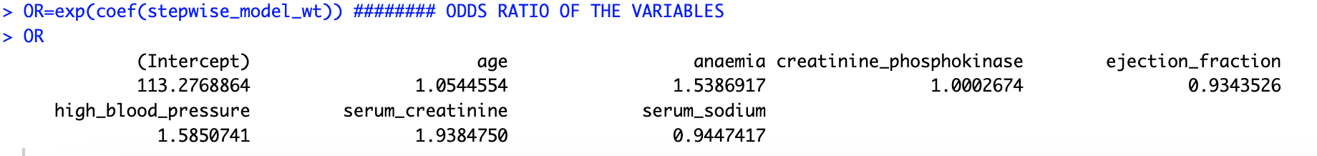
Inference about model parameters
We try to infer the parameters of model from the stepwise selection process.
We use the odds ratio in this process
Here is the R-code output:

Slide 19
Inference about model parameters
These are what the odds ratio are implying for each feature according our model:
Age: Every 1-year increase in age, increases the odds of dying by 5.4%
Ejection fraction: Every 1 unit increase in ejection fraction, decreases the odds of dying by 6.56%
Serum creatinine: Every 1 unit increase in serum creatinine, increases the odds of dying by 93.8%
Serum sodium: Every 1 unit increase in serum sodium, decreases the odds of dying by 5.52 %
Anaemia: Every 1 unit increase in anaemia, increases the odds of dying by 53.8%
High blood pressure: As the odds ratio is greater than 1, we can say that a patients with higher blood pressure have higher odds of dying

Slide 20
Model Performance
We create a confusion matrix to check the accuracy, recall, precision and f1 score of the model.
According to the confusion matrix:
Accuracy = 0.759
Recall = 0.896
Precision = 0.781
F1 Score = 0.417
As this is a model to detect patient surviving, it is better to have a high recall score.
Actual | Predictions
 | 0 | 1
0 | 182 | 21
1 | 51 | 45

Slide 21
Overview
In this project, we have created a model which predicts if a patient survives after a heart failure with a recall of 0.896 and accuracy of 0.75. The model had a deviance/df value of 1.017.
The main features used to predict the probability of surviving are Age, Ejection Fraction, Serum Creatinine, Serum Sodium, Anaemia and High blood pressure.
Future work can be done on this dataset using other binary classification algorithms like Random forest, k-means clustering, etc.

